Slide 1
Lights Out
Jordan Wang

Slide 2
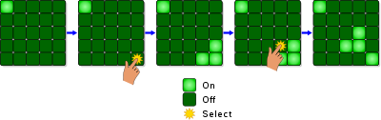
How to play
The game has a 5x5 board with tiles that are on and off. Pressing a tile will invert it and the adjacent tiles, basically making a diamond. To win, you have to get all the tiles off.

Slide 3
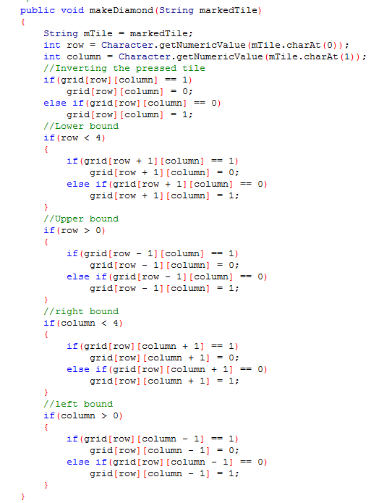
Making the diamond wherever a tile is pressed

Slide 4
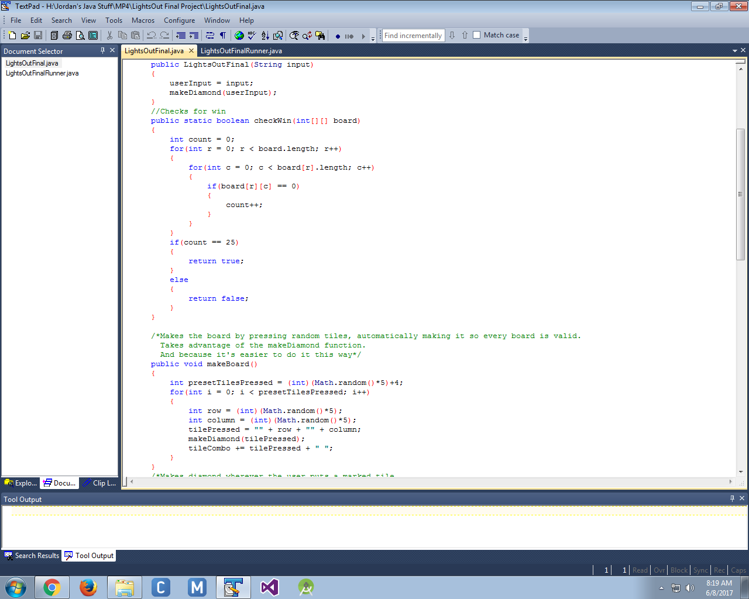
Wins

Slide 5
Making the boards

Slide 6
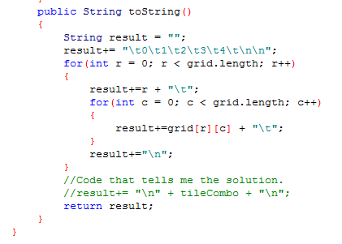
Printing the board

Slide 7
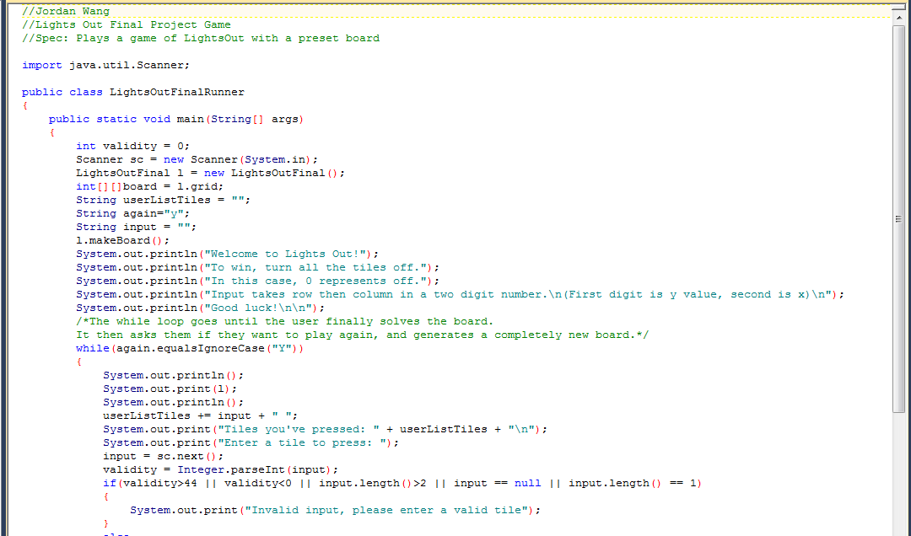
The runner

Slide 8
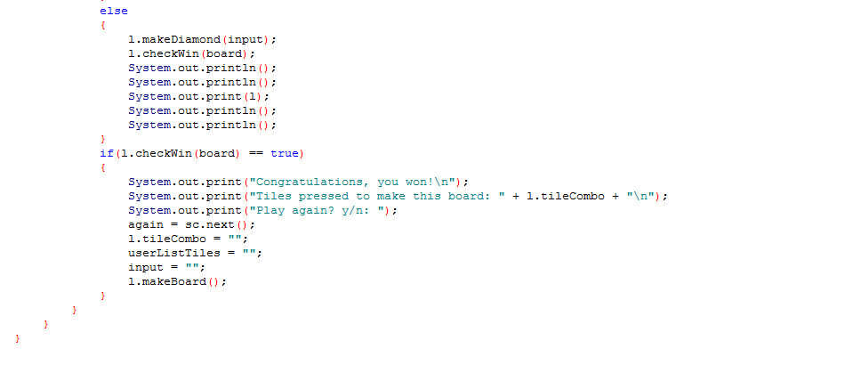
The runner part 2

